Slide 1
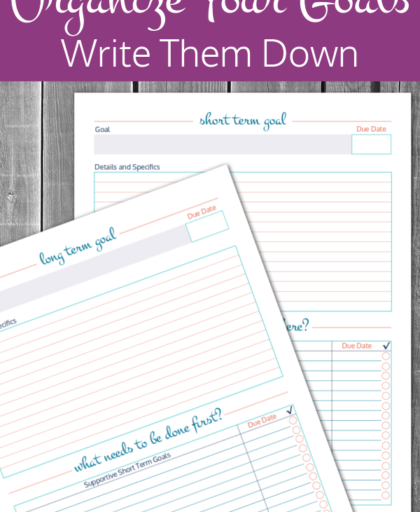
Organized Diary

Slide 2

The problem with many of us we are not able to organize our goals and complete them in a proper manner. Due to this we are not able to use our full capability and our daily tasks remain undone. Sometimes we tend to ignore our most important tasks of our day to complete the least important tasks. So to solve such kind of problem I have made Organized Diary.

Slide 3
The objective of the Diary is to help us do the important tasks first. In this we assign priority to our tasks. And we have to first complete our most prior tasks in order to complete our next task. This will also help us to maintain discipline in our life and also by doing things in this order we can achieve our goals much efficiently. We can also modify our tasks and priority. This diary is mainly designed for daily tasks.

Slide 4


WORKING
Insert your
Tasks.
Assign them priority

Slide 5
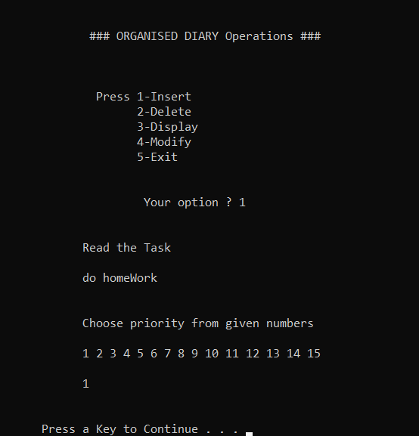
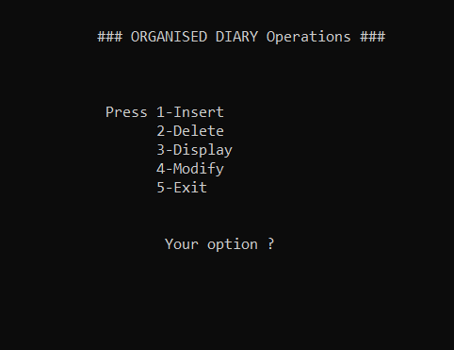
Demo

Slide 6
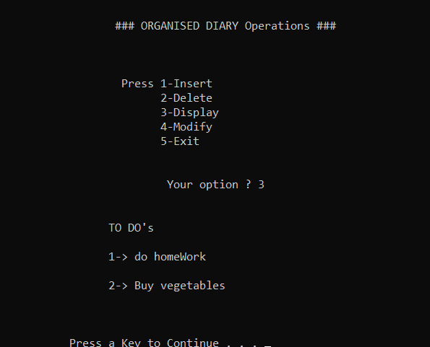
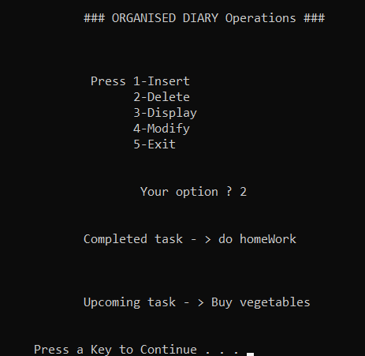

Slide 7
THANK-YOU
By : Ayush Kalra
1910990093

